Slide 1
Annai Violet Arts & Science College Department of Computer Science Naan mudhalvan – Fundamentals of web development
Akash Sharma S
B.Sc Computer Science II – Year
222303192

Slide 2
IBM – SKILL BUILD COURSE
Tamil Nadu Skill Development Course (TNDSC) – FrontEnd Web Development (FEWD)
Completed – 14 Courses.
Attended 8-weeks of Student Development Program (SDP).
Created portfolio and deployed using GitHun.com.
Uploaded the certificate and project link in Naan Mudhalvan Portal.

Slide 3
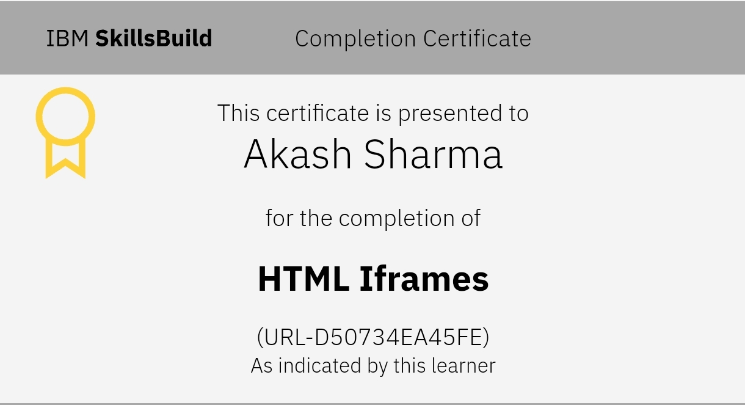
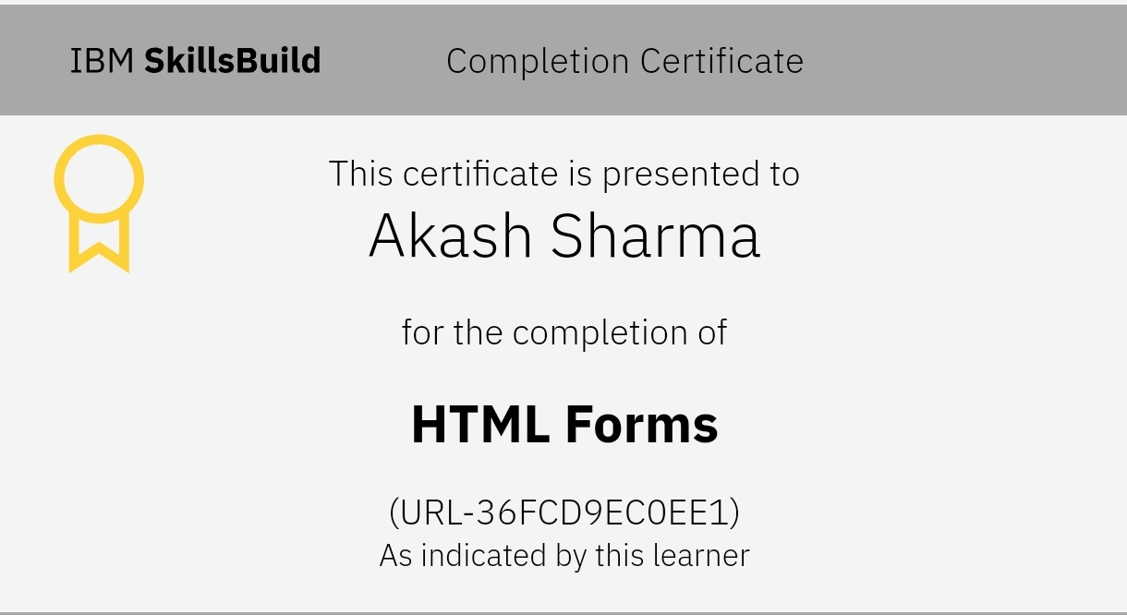
HTML & HTML Web Applications
HTML Iframes
HTML Forms
HTML Iframes - An HTML Iframe is used to display a web page within a web page, Iframes Syntax, Iframes Set Height and Width.
HTML Forms are used to collect user input and send it to the server for processing. A form is created using the <form> element typically contains input fields, checkboxes.

Slide 4
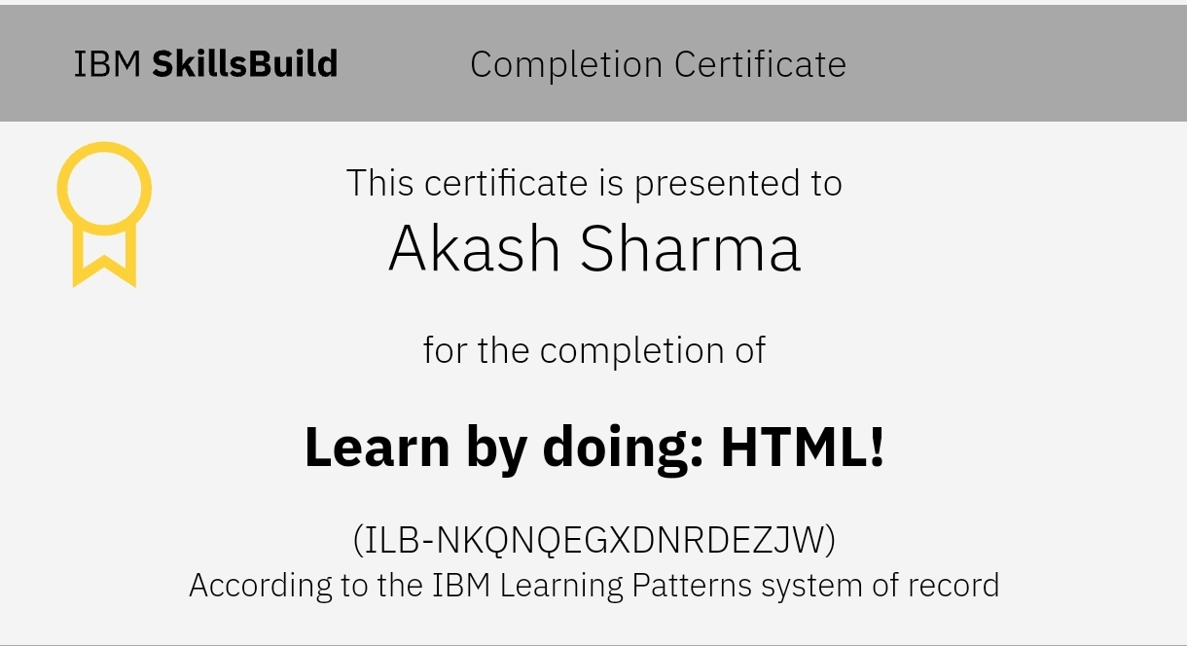
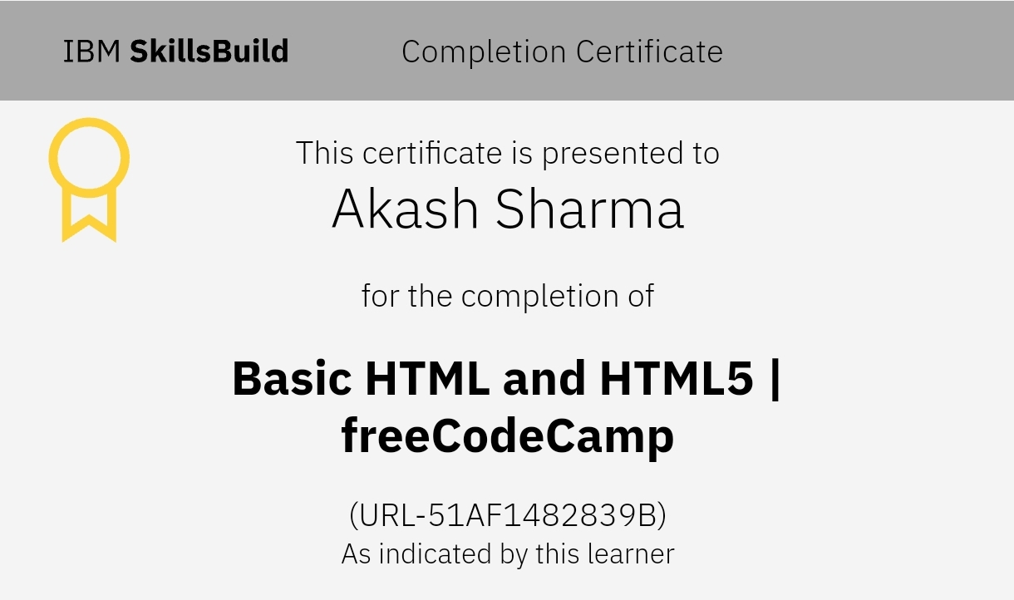
Learn by doing: HTML!
Basic HTML and HTML 5 | freeCodeCamp
Learn HTML autonomously: first take a tutorial then get cracking at these small exploratory exercises, intended to get you up to speed in HTML.
Try out freeCodeCamp's HTML coding challenges! They will walk you through web development step-by-step. In this course, you'll build a cat photo app to learn some of the most common HTML elements - the building blocks of any web page.

Slide 5
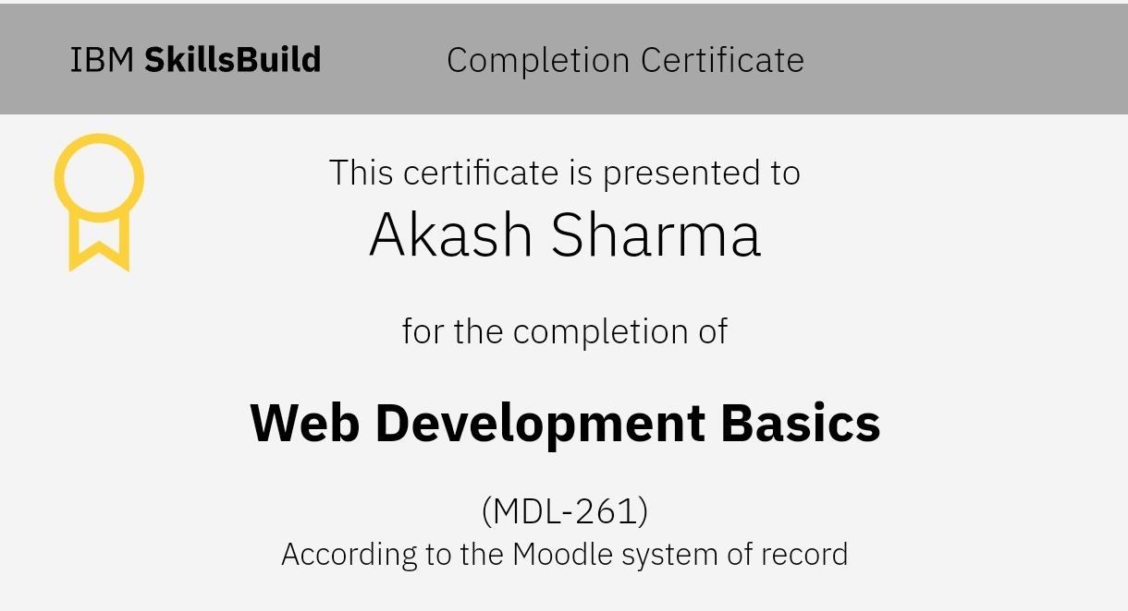
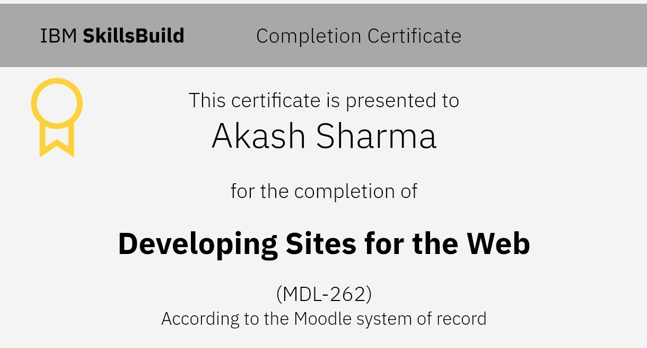
Web Development Basics
Developing Sites for the Web
In this course, you’ll learn about basic computer functions and programming languages. You’ll get an overview of web development, including the scope of the two sides of web development: front-end and back-end. And you’ll learn about the difference between the internet and the World Wide Web.
In this course, you’ll learn how web developers create websites. You will learn about common web development languages including HTML, CSS, and JavaScript, and how they have evolved. You will also learn about the software development lifecycle and ways that an agile approach improves web development.

Slide 6
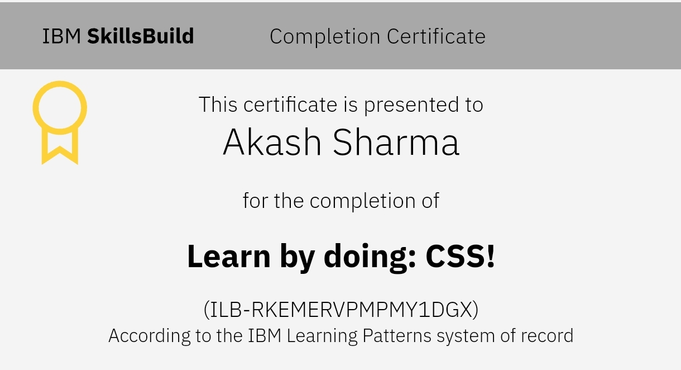
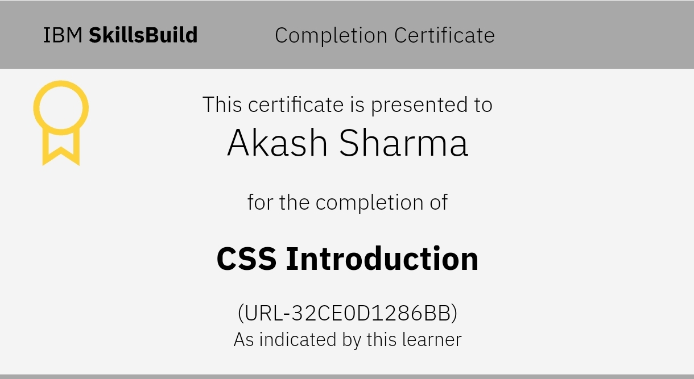
CSS and It’s Properties
CSS Introduction
Learn by doing: CSS!
CSS (Cascading Style Sheets) is a styling language used to control the appearance of HTML elements. It allows you to define colors, layouts, fonts, and more, making web pages visually appealing and user-friendly.
CSS (Cascading Style Sheets) is the language that makes websites beautiful! Instead of just reading theory, let’s learn by doing with hands-on exercises and real examples.

Slide 7
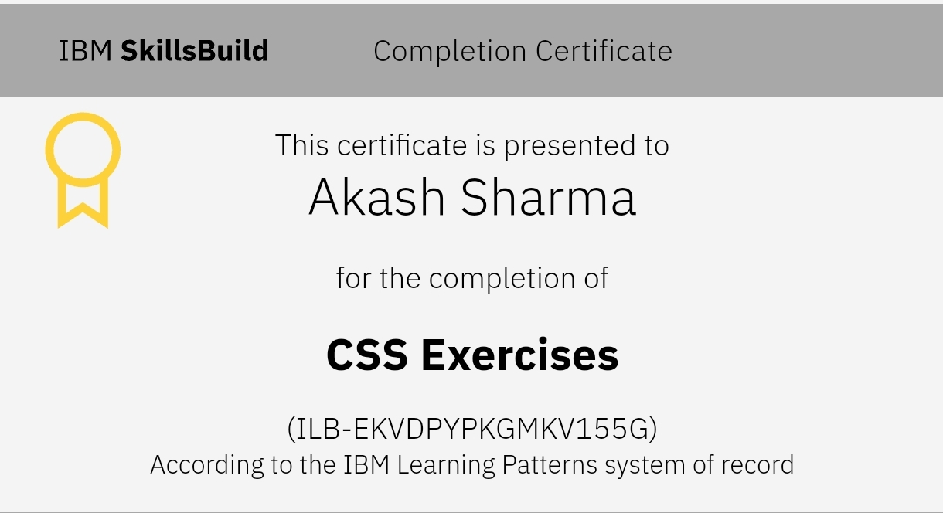
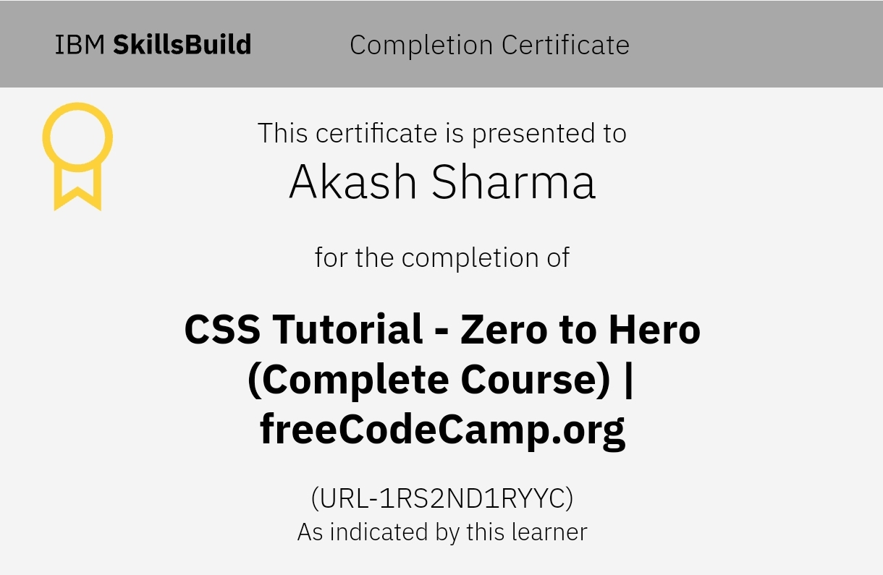
CSS Tutorial - Zero to Hero freeCodeCamp.org
CSS Exercises
CSS is best learned by practicing! Here are some hands-on exercises to improve your CSS skills. Try them out and see your designs come to life!
Learn CSS from the "ground up" in this video-based course for beginners. You can pace your learning to review sections and return to pick up where you left off. This video is presented by freeCodeCamp.org.

Slide 8
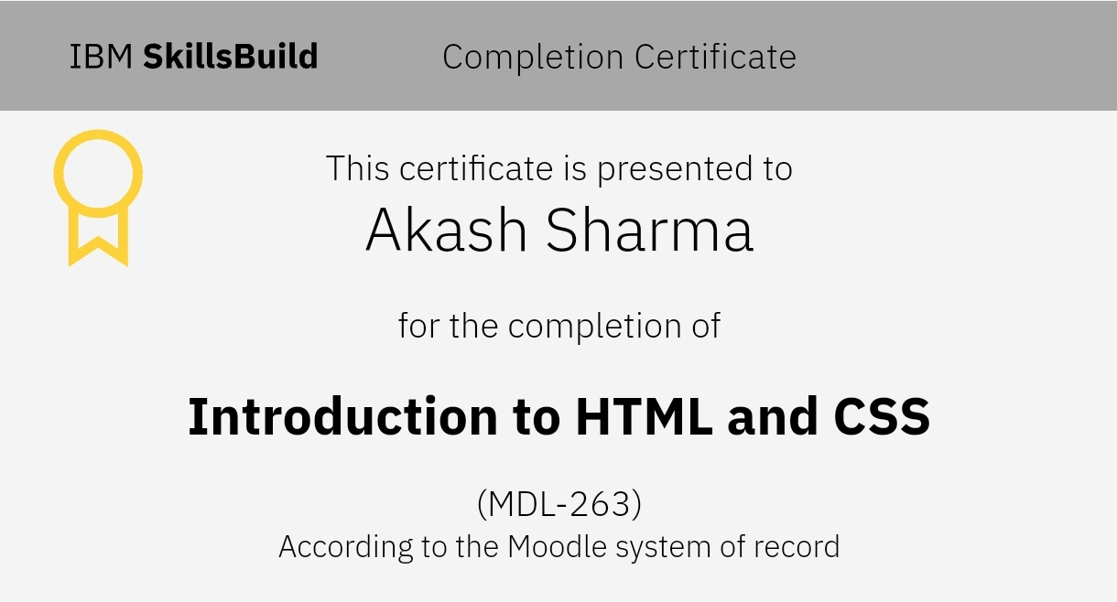
Introduction to HTML and CSS
In this course, you will learn about the basic structure of an HTML document and common elements to build a web page. You’ll explore HTML attributes and understand the importance of organizing information. In addition, you will gain insight into CSS and explore the CSS box model. Finally, you will learn about the best practices web developers use for writing HTML and CSS.

Slide 9
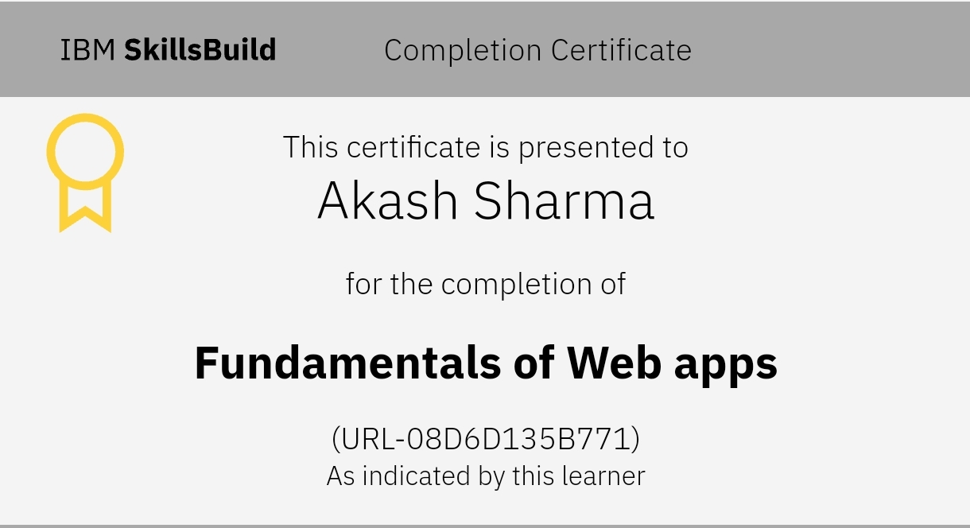
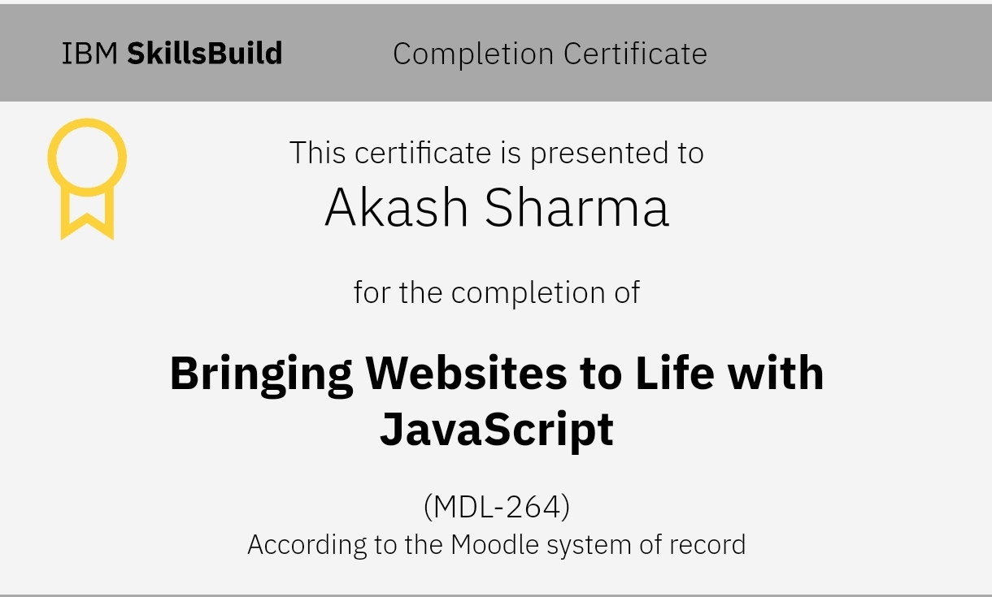
Git and GitHub
Fundamentals of Web apps
Bringing Websites to Life with JavaScript
Web applications (web apps) are dynamic applications that run in a web browser. Unlike traditional desktop applications, web apps can be accessed from any device with an internet connection.
In this course, you’ll learn how web developers use JavaScript with HTML to create dynamic websites. You’ll examine JavaScript syntax and how variables, functions, expressions, and events operate in JavaScript code.

Slide 10
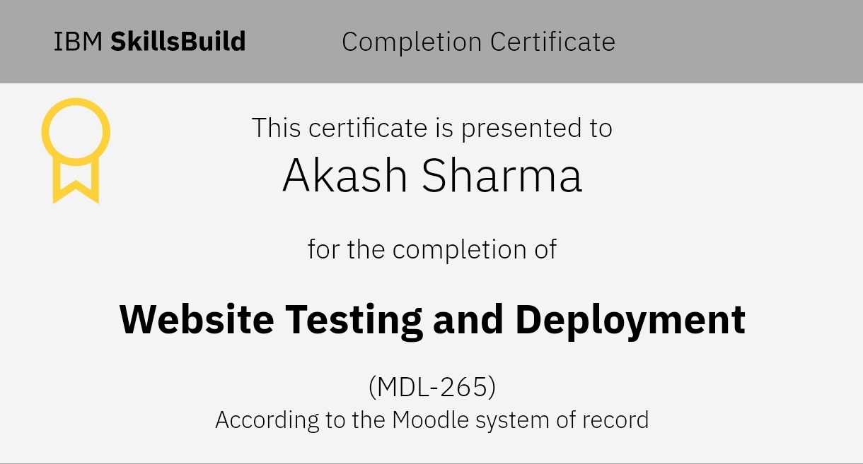
Website Testing and Deployment
In this course, you will explore how developers thoroughly test website code before enabling public access to their sites. You’ll discover how teams use version control systems to speed up the delivery of new features and functionality to their users. And you’ll learn about the tools and processes developers use to streamline and simplify the deployment of their websites to their servers or the cloud.

Slide 11
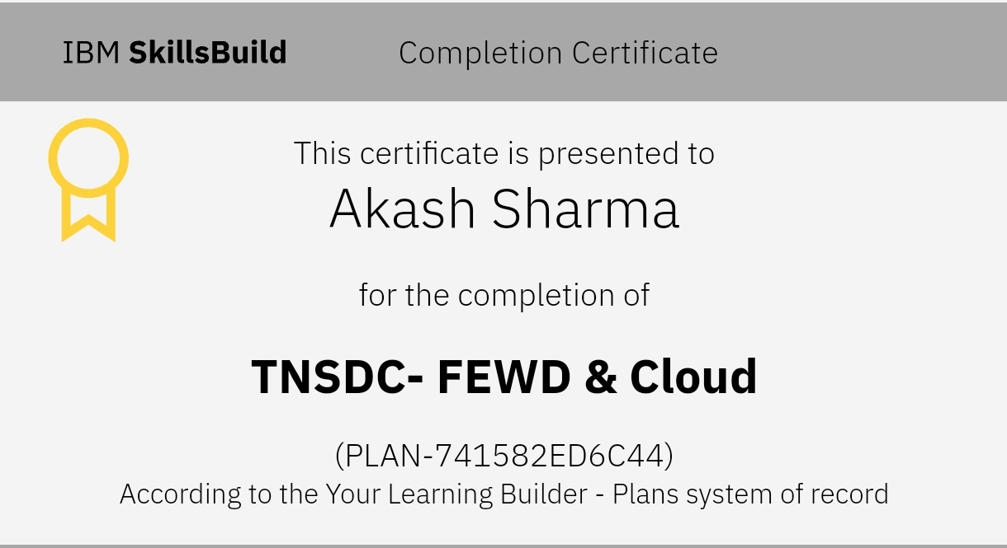
Naan Mudhalvan – Fundamentals of Web Developments
TNSDC – FEWD & CLOUD CERTIFICATE
This is a comprehensive program designed to equip learners with the necessary skills and knowledge to become Front End Development. The program covers key concepts, tools, and technologies in web development. This will be the first Step for the Students who want to Become Front-End Developers. Students will be Going through the Basic Concepts of HTML, CSS and JavaScript. AS well as they also understand the basic Concepts of Cloud Computing. Students will also learn to deploy their Webpages in Git and GitHub.

Slide 12
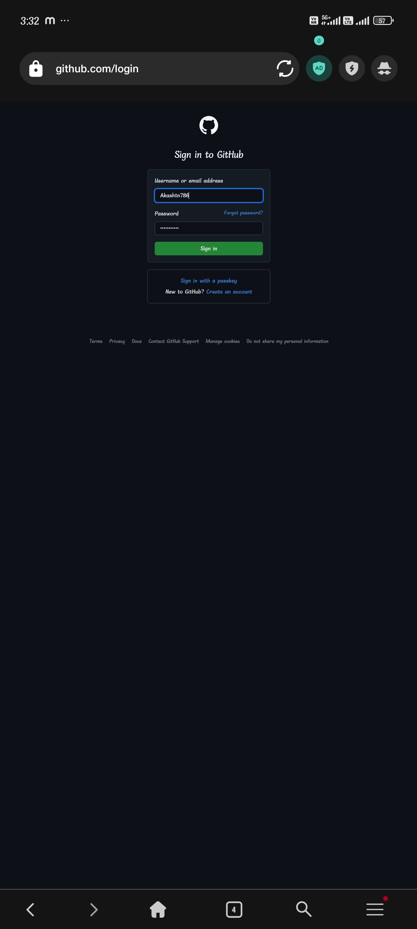
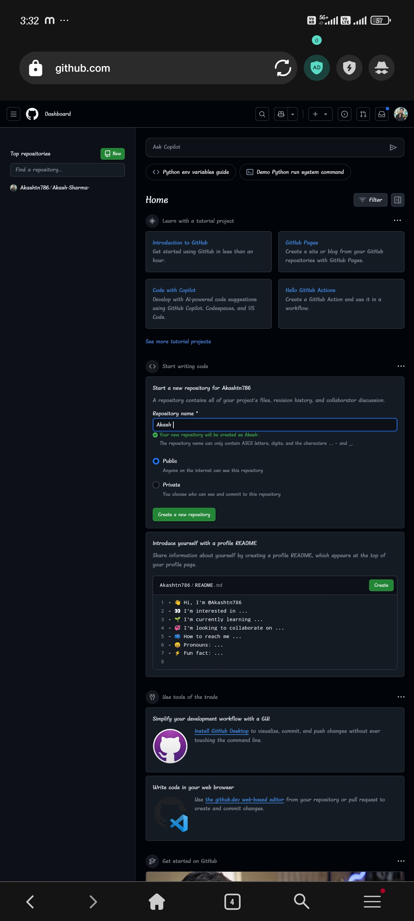
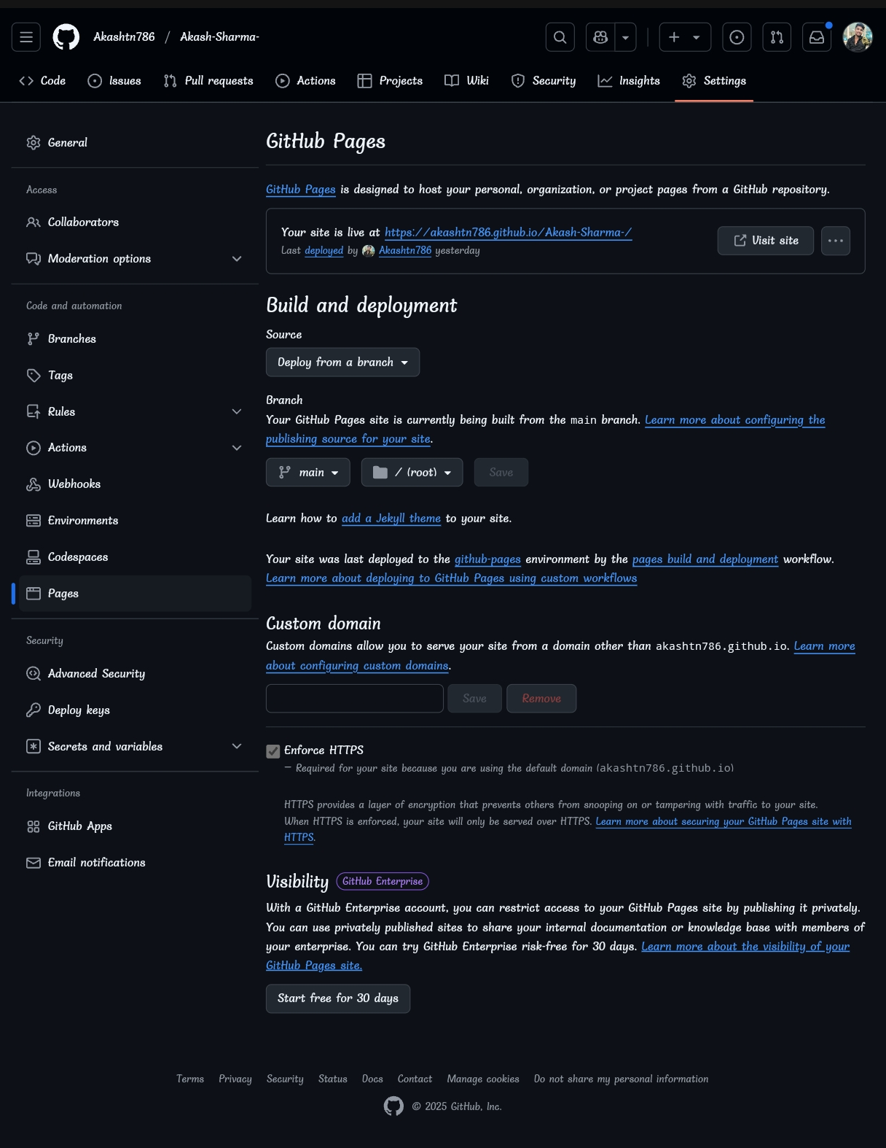
Naan Mudhalvan – Fundamentals of Web Developments
GitHub Login Create New Repository
In settings go to Pages change to main and root

Slide 13

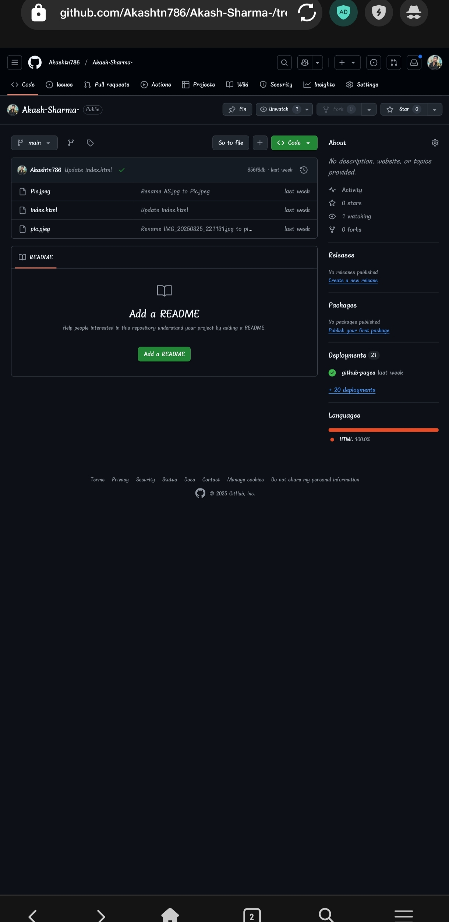
Naan Mudhalvan – Fundamentals of Web Developments
Add the Code &
Picture File
In pages go to GitHub repository
Go to Deployments done

Slide 14
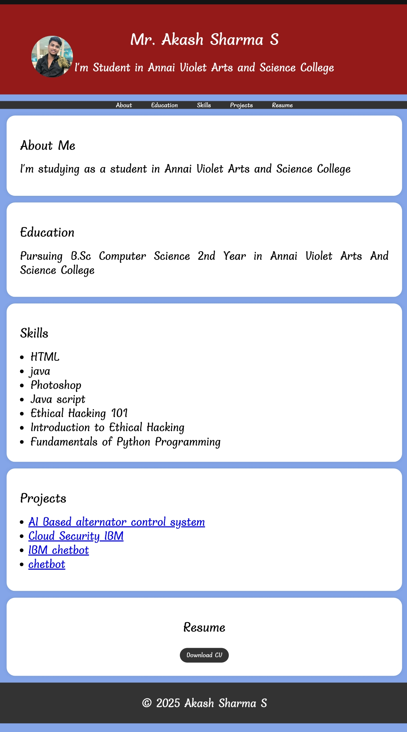
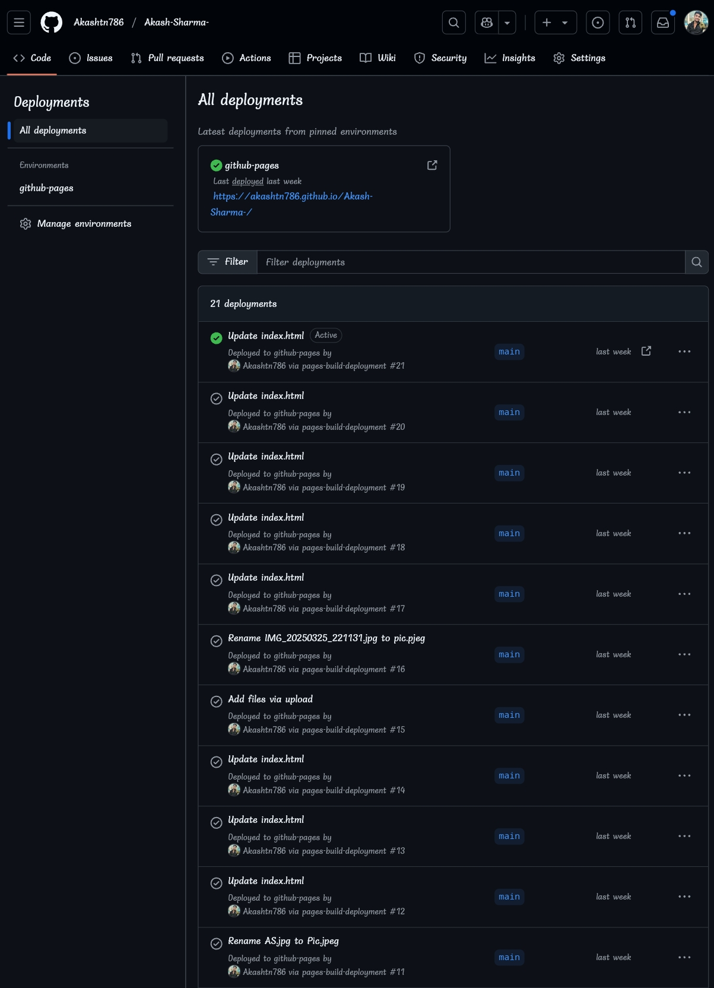
Naan Mudhalvan – Fundamentals of Web Developments
This is my Portfolio Websites
Check the uploaded file in the deployments done

Slide 15
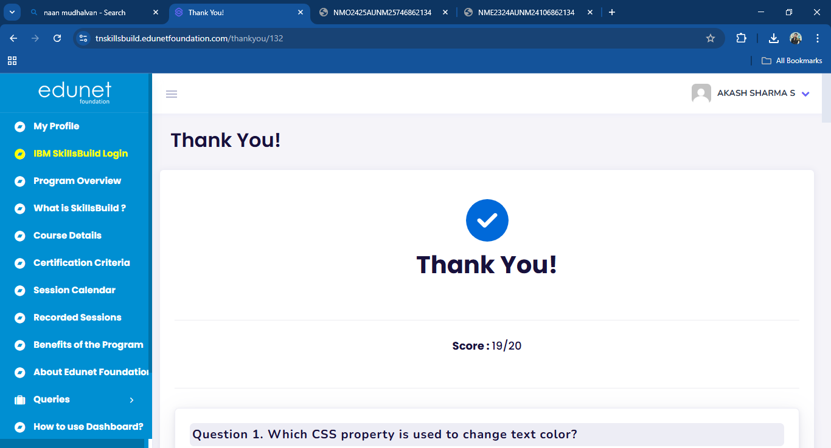
Naan Mudhalvan – Fundamentals of Web Developments
Naan Mudhalvan – Quiz Assessment

Slide 16
Thank You…

